Slide 2
What we do:
isla vista beautiful hires individuals that have recently experienced or are currently experiencing homelessness to complete an array of community improvement projects, such as clean up graffiti, pick up trash, weed and landscape, and resolve miscellaneous issues.

Slide 3
How we unite the community:
isla vista beautiful is a unique opportunity to unite different segments of the Isla Vista community. Community members--students, residents, business owners, etc.--can submit issues through the SeeClickFix app, a photo-uploading platform where they can identify various issues and track when those issues are corrected through regular status updates and “before-and-after” pictures.

Slide 4
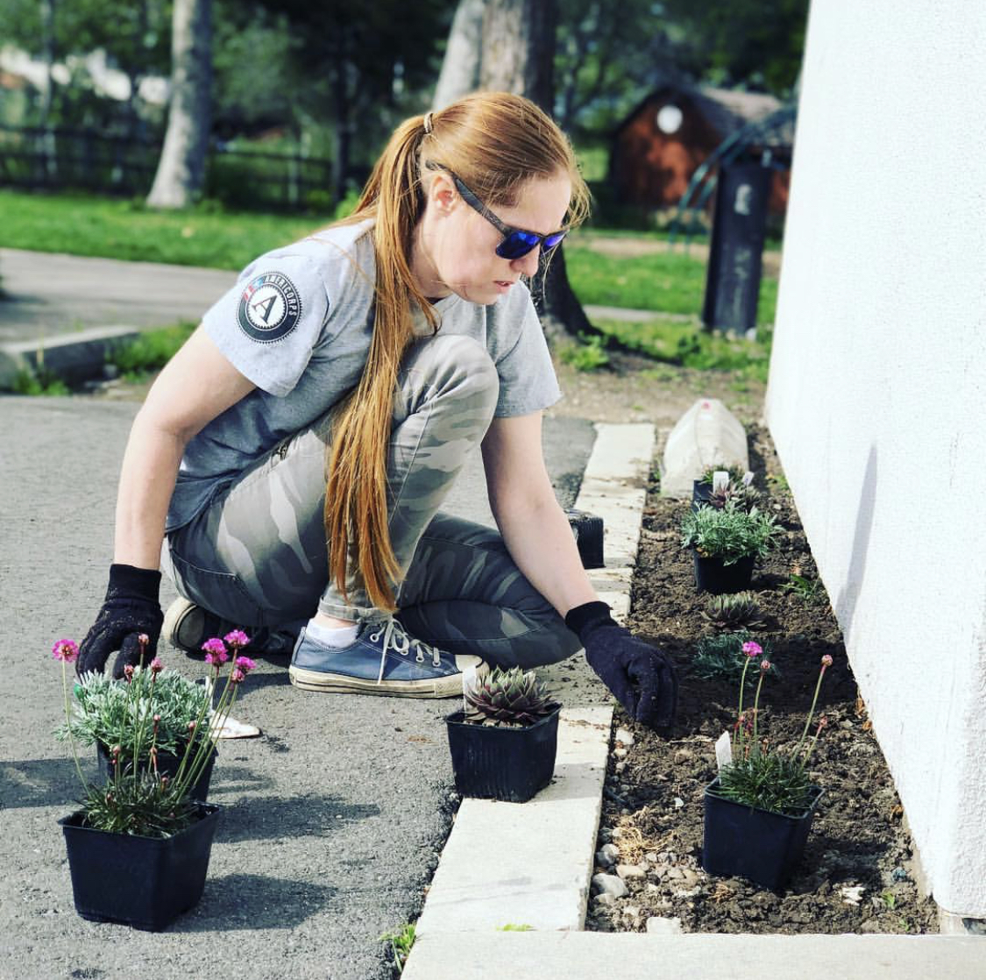
Pilot Project:
1 Coordinator + 1 Minimum Time AmeriCorps Member
+ 2 Beautification Staff

Slide 5
TOTAL SEECLICKFIX REQUESTS
April 2019 – Present
Category | Total Created | Closed | Open
Graffiti - Private Property | 92 | 87 | 5
Graffiti - Marborg Property (dumpsters) | 61 | 61 | 0
Graffiti - Public Property (Sidewalks, roads, street signs, community center, etc.) | 39 | 28 | 11
Graffiti - Verizon Property (Light green electrical box, sidewalk access hatch) | 4 | 4 | 0
Graffiti - Parks (Tables, benches, trees,etc.) | 5 | 1 | 4
Obstruction to Public Right of Way | 20 | 20 | 0
Trash / Garbage | 23 | 21 | 2
Landscaping | 28 | 24 | 3
TOTAL REQUESTS | 272 | 246 | 26

Slide 6
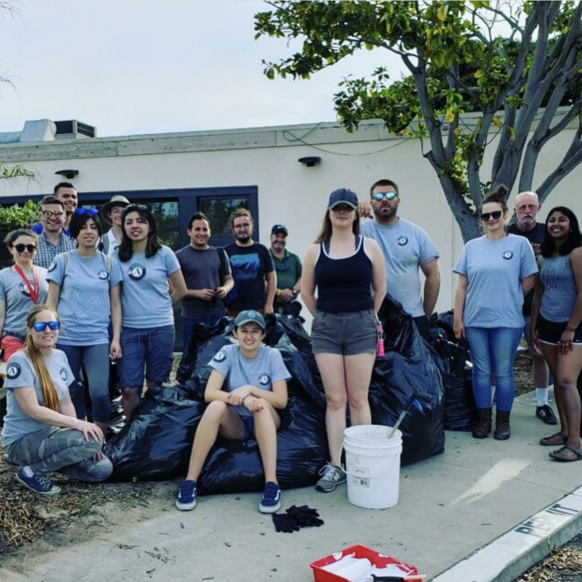
Service Day

Slide 7
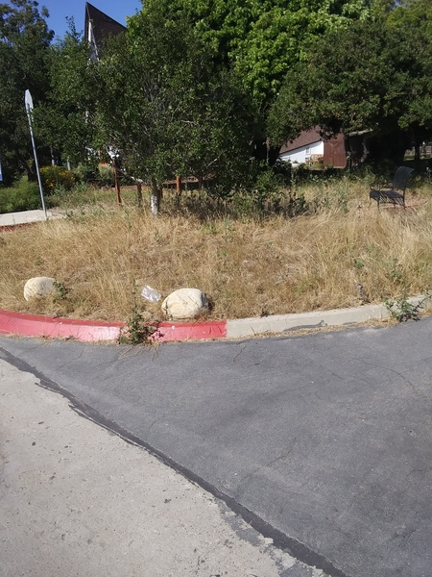
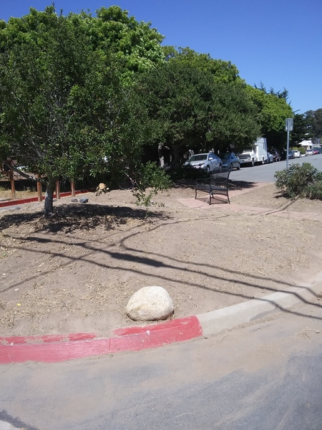
BEFORE
AFTER

Slide 8
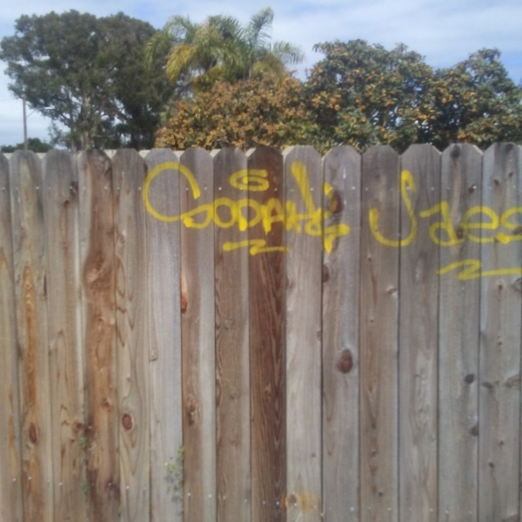
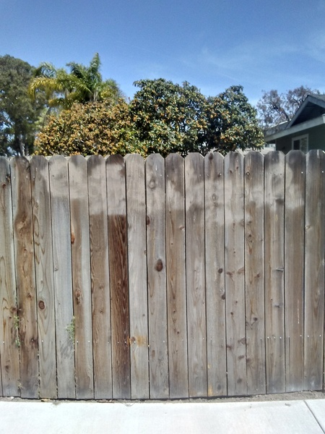
142 submitted 93 acknowledged 57 closed

Slide 9
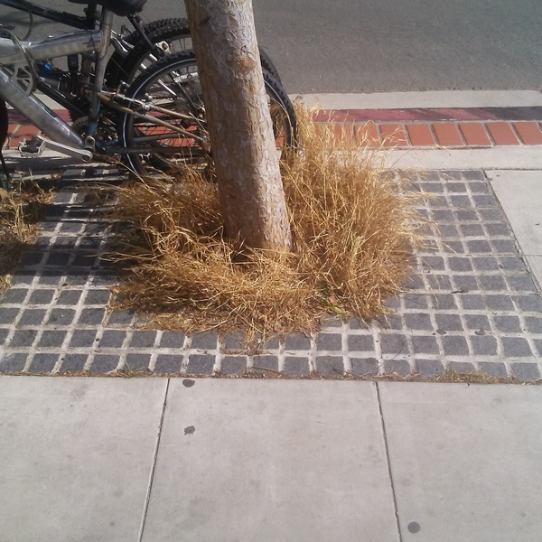
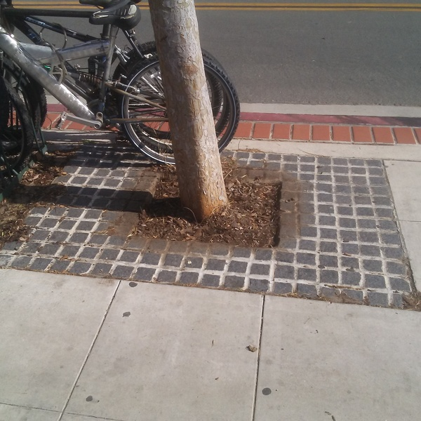

Slide 10
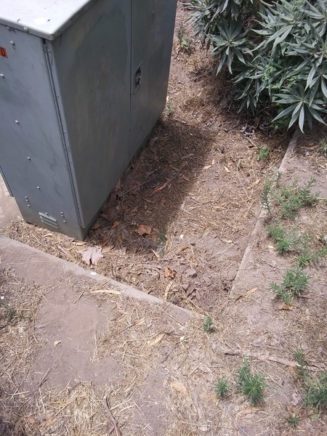
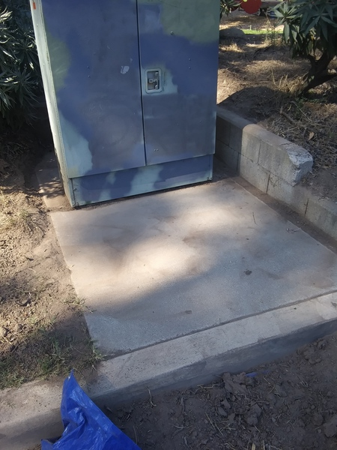
BEFORE
AFTER

Slide 11
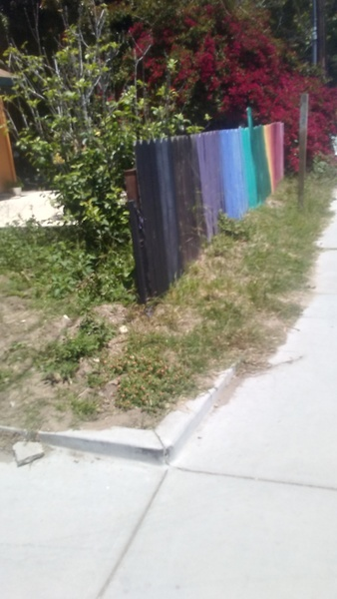
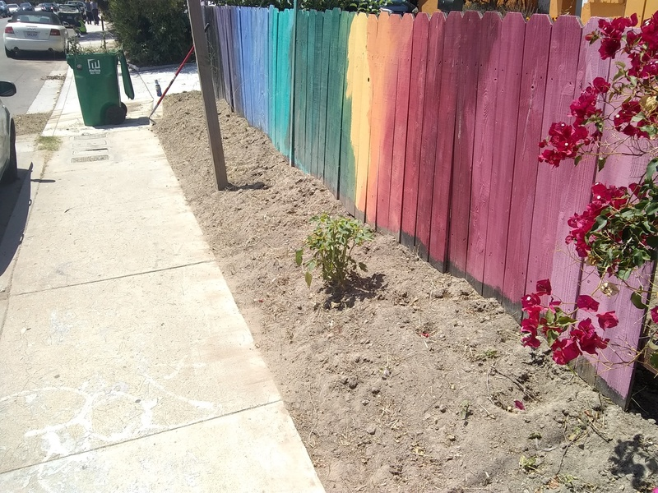
BEFORE
AFTER

Slide 12
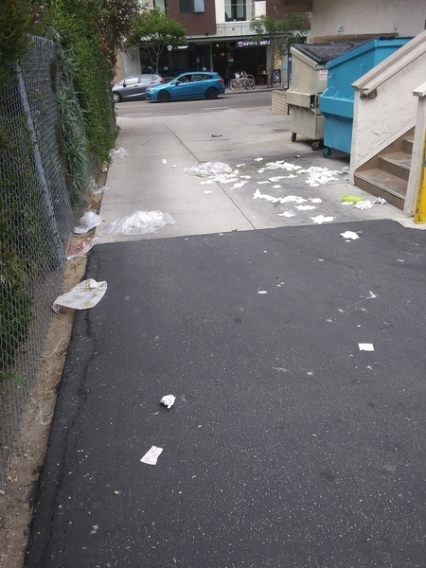
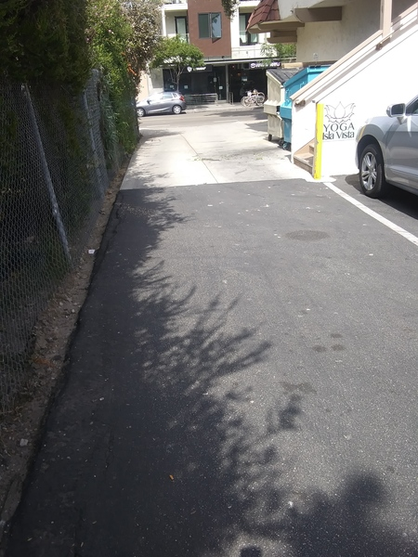
BEFORE
AFTER

Slide 13
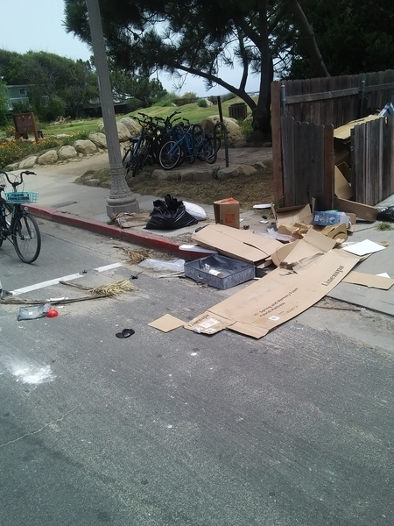
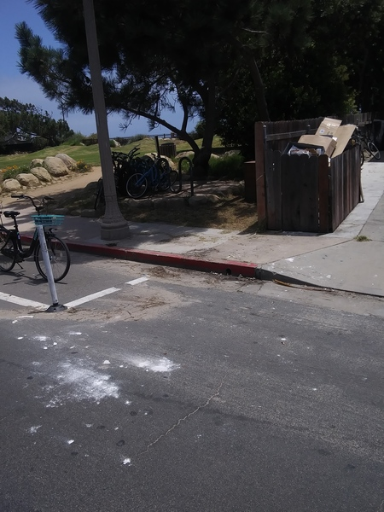
BEFORE
AFTER

Slide 14
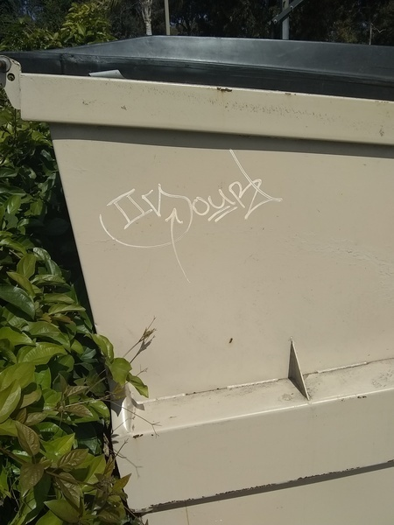
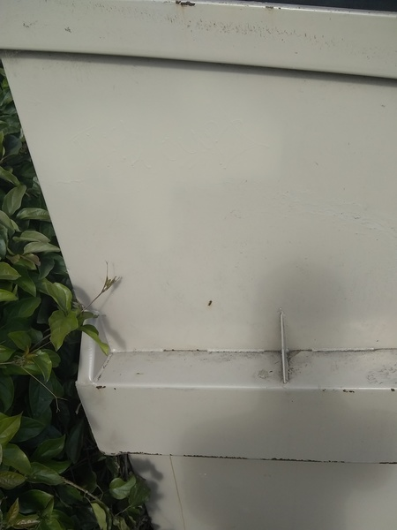
BEFORE
AFTER

Slide 15
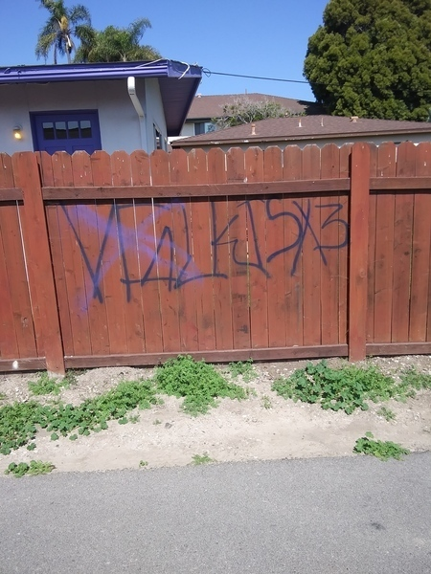
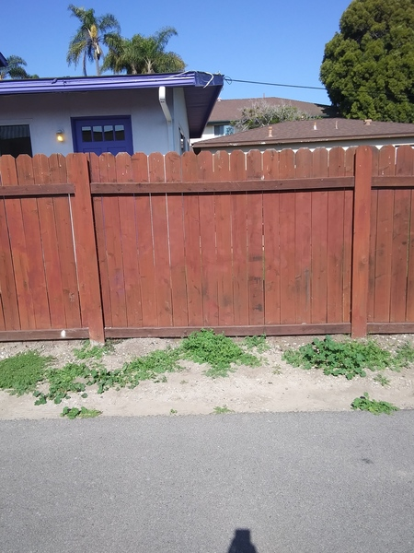
BEFORE
AFTER

Slide 16
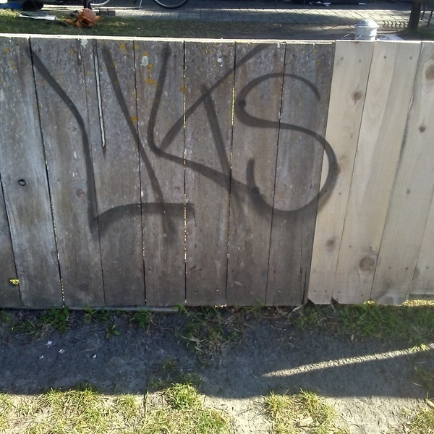
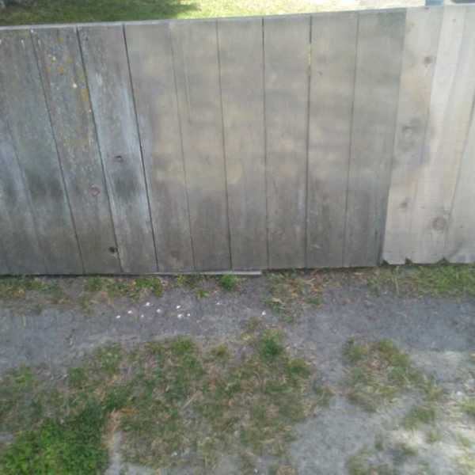
BEFORE
AFTER

Slide 17
Project:
1 Coordinator + 1 Minimum Time AmeriCorps Member
+ 1 AmeriCorps VISTA + 4-5 Staff

Slide 18
Project:
We hope to expand staffing with the anticipation of an increase in issue submission with the impending school-year. With increased staff, we can empower more individuals with work experience and references and equip them with the necessary tools to transition out of homelessness. The addition of a United Way Home for Good Staff member and an AmeriCorps VISTA will facilitate management and allow for the development of more special projects, such as marketing initiatives, community member SeeClickFix app engagement, and volunteer opportunities for beautification.

Slide 19
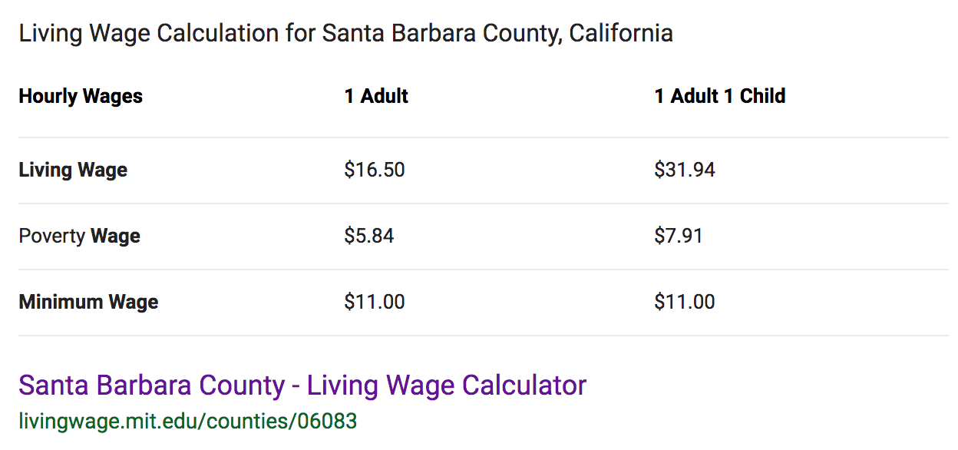

Slide 20
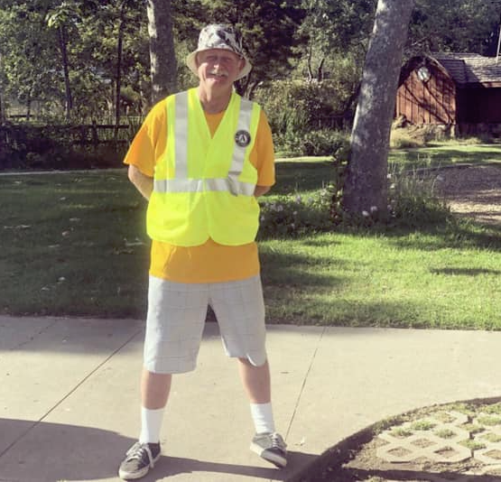

Slide 21
Thank you!

